Slide 1
Look at the following slides. Analyze each piece using CONTENT, SENSORY, FORMAL, AND EXPRESSIVE PROPERTIES.
Content: can be determined by asking the following questions:
Why do you think the artist made this work?
What is he/she trying to tell me about the subject? What is the purpose?
What are the major and minor themes in this work?
Sensory Properties: things we experience with our senses – sight, touch, etc.
The elements of create the sensory properties. You should be able to identify which elements are used in a work of art or dominate the piece – line, shape, form, color, value, texture, space, and light. List as many sensory properties as you can identify and how it’s evident.
Formal Properties: tell us how the elements of art are organized in a work of art
pattern, balance, movement, rhythm, unity, variety, emphasis, contrast, and proportion.
List as many formal properties as you can identify and how it’s evident.
Examples of questions that establish formal properties:
What (if anything) is the center of interest? {emphasis}
How does my eye move through the work?
Does the work have a sense of rhythm? Why?
Technical Properties: refer to the use of tools, media, and techniques
(Pencil, oil paint, wood, type of brushstrokes, highly detailed, abstract, etc.)
Expressive Properties: tells us what the work says literally, metaphorically, and symbolically.
Sample questions: Is the work timid or bold? Does it establish a time reference? Does is have a symbolic or religious significance? Is it literal or symbolic? You may ask yourself different questions in order to explain the expressive properties.

Slide 2
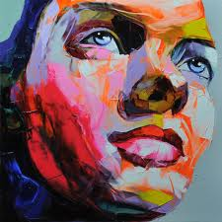
Sample.
Content: I think this painting was made because the artist probably knew the subject and wanted to use expression to capture their personality.
Sensory: Color – the colors that are used are very expressive and bright.
Form – a realistic 3-D version of a woman is portrayed
Value and Light – light values and white capture the highlights and the light source that is shining on her face, and dark values show shadows and inset parts of her face.
Texture: the use of color does not create a smooth texture on the skin. It is more expressive.
Formal: Unity – the picture comes together by using bright colors and a worm’s eye point of view. There is very little background to compete with the subject.
Emphasis – the close-up of the face and the use of bright red creates emphasis on the subject matter and minimizes the need for a background.
Variety – there are a variety of colors and brushstrokes used, which adds to the expressive nature.
Expressive: I believe the artist has drawn the figure realistically, but the colors and closeness gives a more expressive feel. These things also give it a more bold look. By not having a background, the woman appears more life-size. She is looking off into the distance, so it creates distance between her and the viewer – she’s not directly connected to the viewer. Even though some of the colors are very bright and bold, her eyes have a somber and calm feel.

Slide 3
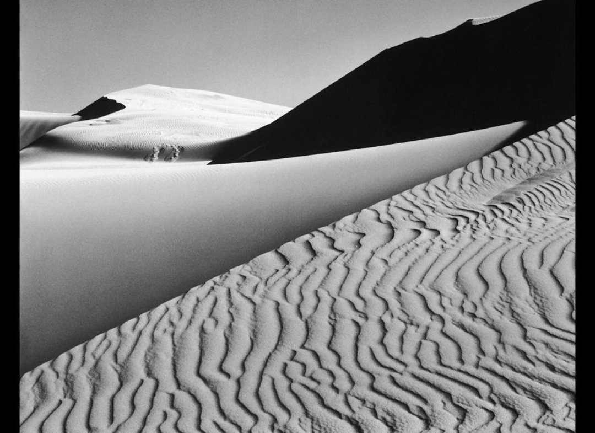
Ansel Adams – Black & White Photo

Slide 4
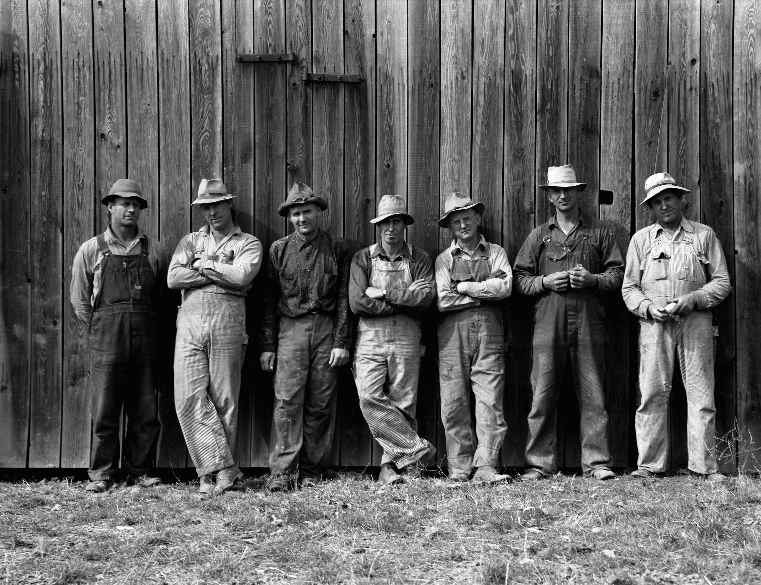
Dorothea Lange – Black & White Photo

Slide 5
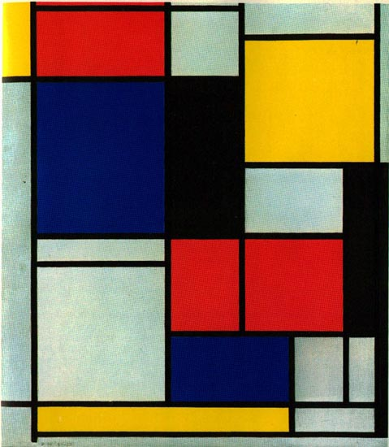
Piet Mondrian – Abstract Painting

Slide 6
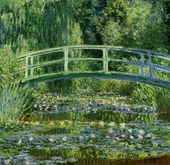
Monet - Landscape

