Slide 1
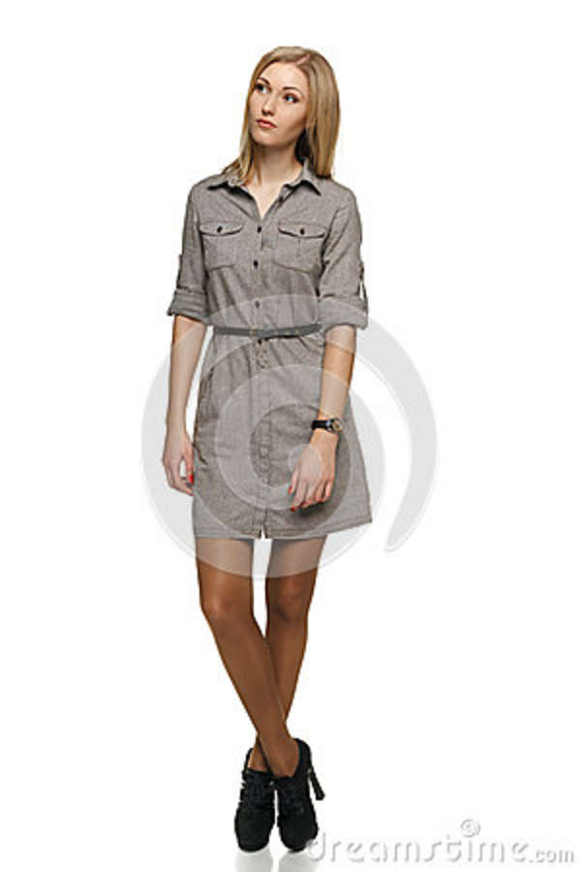
Notes:
Static Pose 1 – other than crossed legs, no active movement or shift in weight. Straight torso.

Slide 2
Notes:
Again, no shift in weight, straight torso, head in stationary position

Slide 3
Notes:
Vertical movement – straight torso and neck

Slide 4
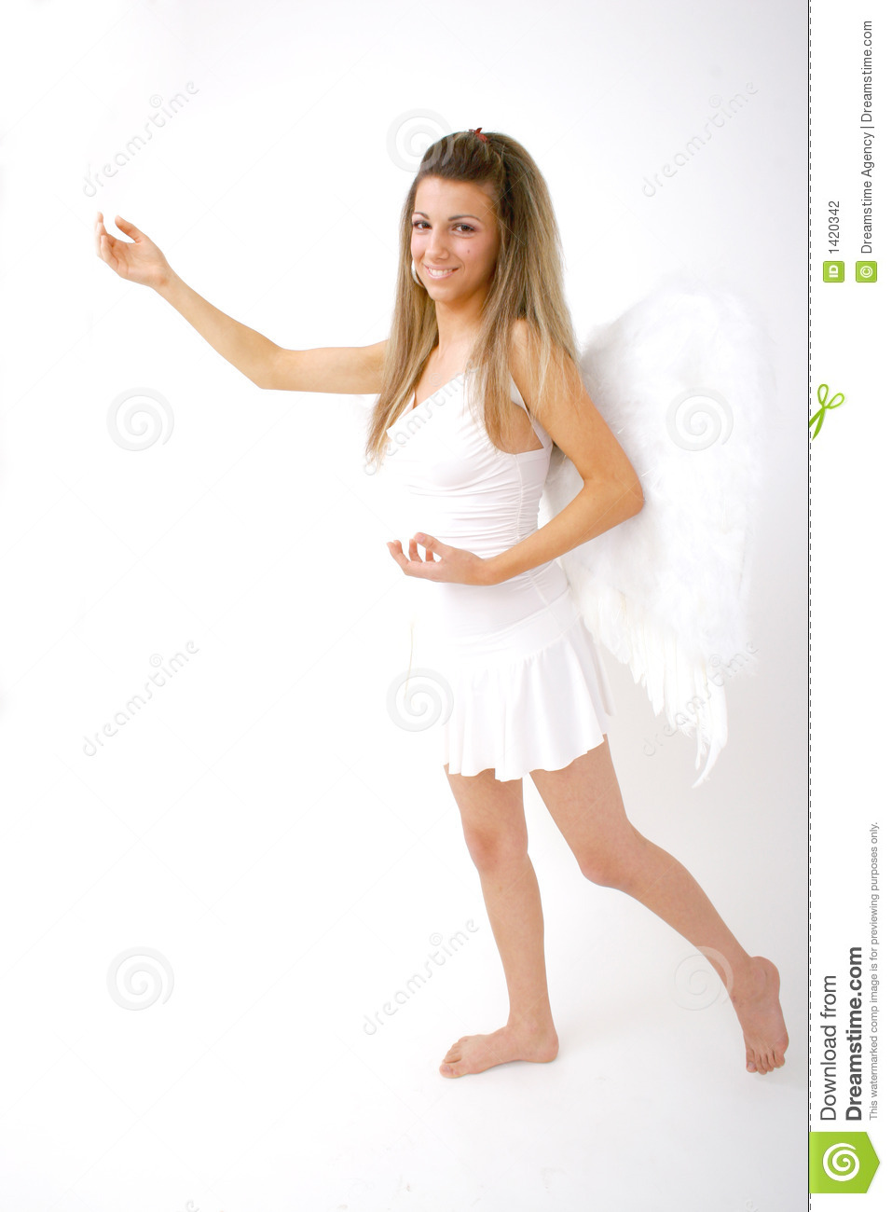
Notes:
Shift in weight, straight torso and neck

Slide 5
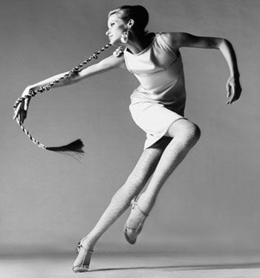
Notes:
Dynamic 1

Slide 6
Notes:
Dynamic 2

Slide 7
Notes:
Dynamic 3

Slide 8
Notes:
Dynamic 4

Slide 9
Notes:
Dynamic 6

Slide 10
Notes:
Gesture 1

Slide 11
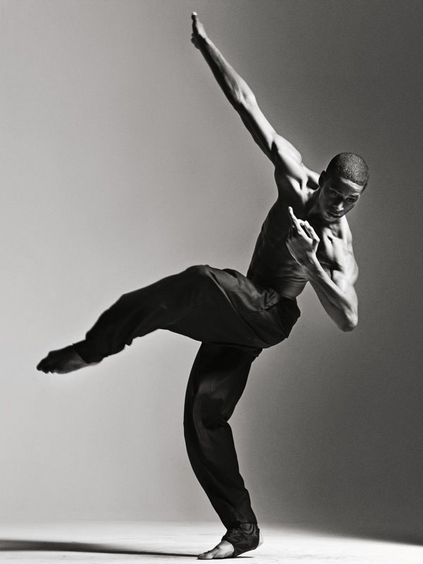
Notes:
Gesture 2

Slide 12
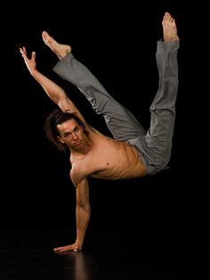
Notes:
Gesture 3

Slide 13
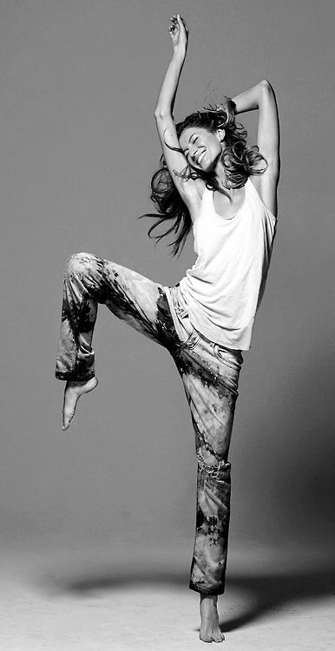
Notes:
Gesture4

Slide 14
Notes:
Gesture 5

Slide 15
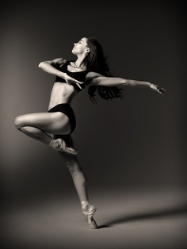
Notes:
Gesture 6

